Slide 1
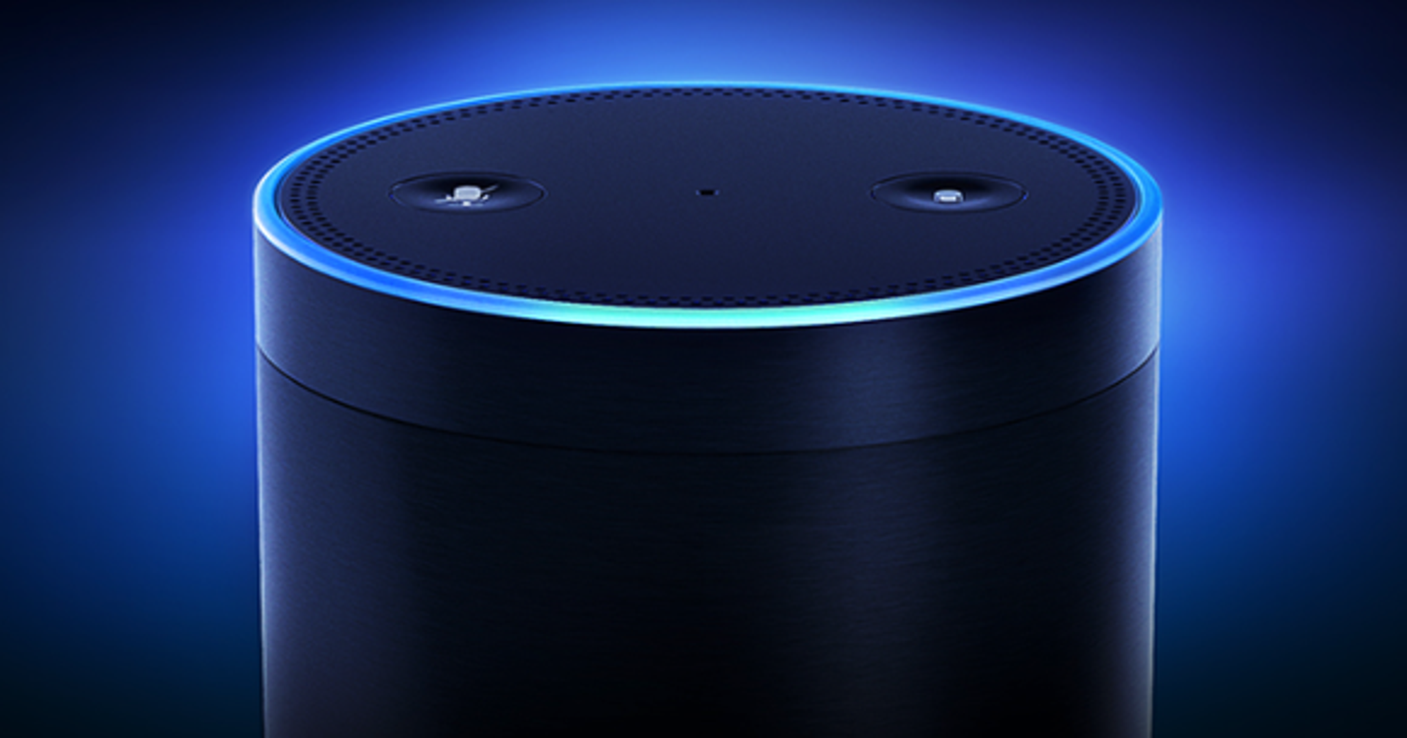
Automated Speech Recognition for Alexa
Priyanka Upadhyay, Jeremiah Stone, Shuo Wang

Slide 2
Problem Statement
Datasets
Voice-based applications require a "wake word" (e.g. Alexa)
Automatic Speech Recognition (ASR) domain, where the machine learning models identify if the spoken words match with a specific target word
Kaggle Alexa dataset (https://www.kaggle.com/datasets/aanhari/alexa-dataset)
369 Recordings of Alexa keyword “Alexa” in different voices.
Audio files of the word ‘Alexa’ in different voices and accents, therefore adding both complexity and diversity to the dataset, therefore reducing bias in our model.
LJ Speech (https://www.kaggle.com/datasets/mathurinache/the-lj-speech-dataset)
Public domain speech dataset consisting of 13,100 short audio clips of a single speaker reading audiobooks.
Larger than the first dataset, and has words other than ‘Alexa’, which makes it a generalizable dataset for our models.
Drawbacks: only a single voice & accent for all the words.

Slide 3
Approach/ Methodology
The data consist of audio files in .wav format. We converted .wav files to a spectogram.
(i) Used the decode function to convert WAV to a time series of amplitudes of the audio in the file.
(ii) Converted the audio frames from time domain to frequency domain with specified window length of 256ms into spectrograms.
(iii) Normalized the spectrograms data with a z-score transformation that gives us our sample features of 193.
Encoded the labels by converting characters to a number (space->0, A->1, B->2, …., nan->31).
“alexa” would be encoded as: [ 1 12 5 24 1].
Built a loss function to compute the training time loss value using the CTC Loss algorithm. To make sure that the prediction and the true label have the same shape, we used the TF shape function.
Used another decoder function to convert the predictions (that are returned in numbers) into alphabets.
Developed accuracy functions to evaluate the models.
Trained 6 set of models.

Slide 4
Evaluation parameters
We developed the following accuracy functions:
A relative accuracy function, where we match the prediction with a true label, character by character. If the two characters match, it is a 1, otherwise 0. Then we calculate the average for each prediction, which becomes the accuracy score for that prediction.
An absolute accuracy function, where we match the full word/sentence with the true label. If the two match, it is 1. Otherwise 0. This is a much more stringent accuracy function, as the full word has to match with the true label.
We also used Word Error Rate (wer), a built-in function in the JIWER package as a measure of accuracy.
If a model can predict the word ‘Alexa’ with >50% accuracy, then the model will be considered successful.

Slide 5
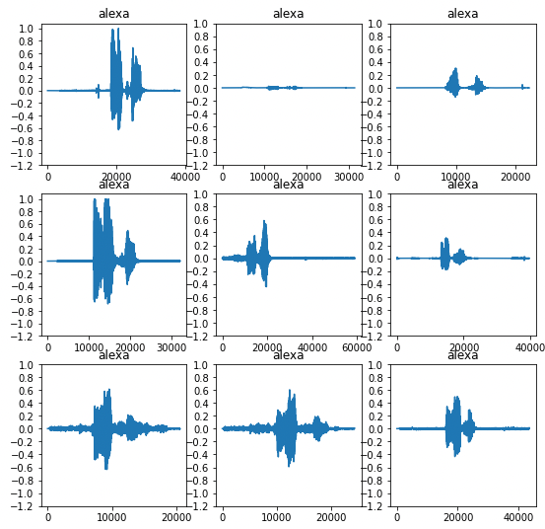
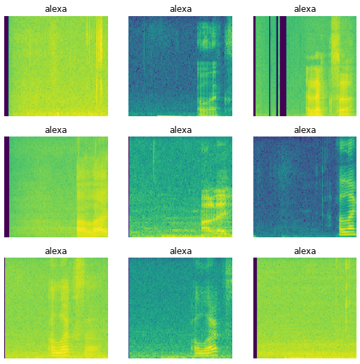
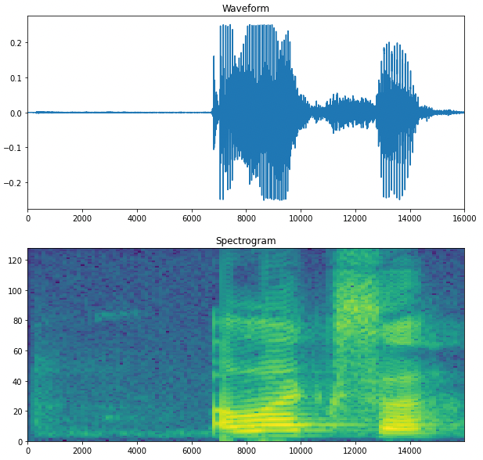
“alexa” waveforms & spectrograms
Examples of “alexa” waveform variance
Examples of “alexa” spectrogram variance
Example of “alexa” waveform and corresponding spectrogram

Slide 6
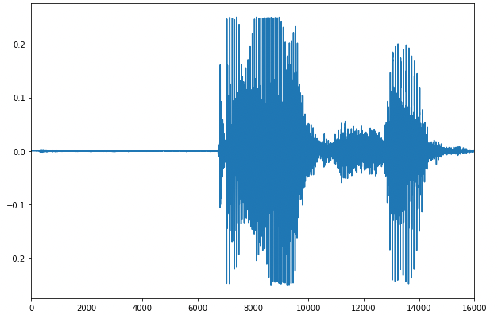
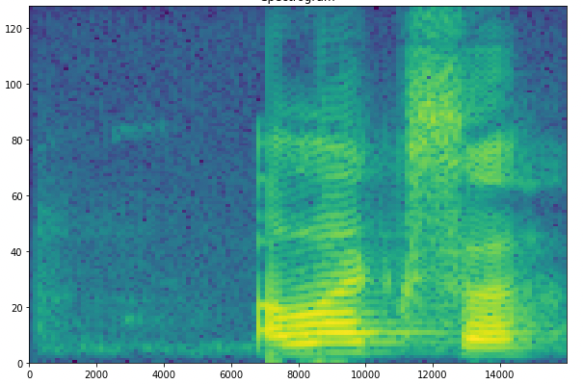
Research Process
Feature Encoding Spectrograms (time frequency domain images)
Audio files (.WAV)
Model Testing
Model Evaluation
Relative Accuracy
Absolute Accuracy
Word Error Rate
Research Data
Trained Models
Test: 10%
Features
Train: 80%
Model Training
Validate: 10%
Model Tuning
Relative Accuracy
Absolute Accuracy
Word Error Rate
Transcripts
alexa
Label Encoding
Define Vocabulary
Convert Vocabulary to int
Map transcript to vocabulary int representation
Labels
Train / Validate Loop
the invention of movable metal letters…

Slide 7
Models and Results
Basic Models, Logistic and Artificial Neural Networks
Model Name | Model Type | Hidden Layers | Hidden Units | Dataset (train, validation, test) | Accuracy | Abs Accuracy | Word Error Rate
model000 | Multi-Classification |  |  | Alexa (80%,10%,10%) LJSpeech(0%, 0%, 10%) | 2.4% 2.5% | 0% 0% | 1.05 1
model001ann | Artificial Neural Network | 1 | 256 | Alexa (80%,10%,10%) LJSpeech(50%, 0%, 10%) | 0% 0% | 0% 0% | 1 1
model002ann | Artificial Neural Network | 2 | 256, 128 | Alexa (80%,10%,10%) LJSpeech(50%, 0%, 10%) | 0% 0% | 0% 0% | 1 1
model003ann | Artificial Neural Network | 3 | 256, 128, 64 | Alexa (80%,10%,10%) LJSpeech(50%, 0%, 10%) | 20% 0.18% | 0% 0% | 1 0.98
Convolutional Neural Network
Model Name | Model Type | Dataset (train, validation, test) | Accuracy | Abs Accuracy | Word Error Rate
model007 | 2D Convolutional NN | Alexa (80%,10%,10%) LJSpeech(0%, 0%, 10%) | 51% 0.15% | 0% 0% | 1 1

Slide 8
Models and Results
Recurrent Neural Networks Trained on Alexa Dataset
Model Name | Model Type | Hidden Layers | Hidden Units | RNN Layers | RNN Units | Dataset (train, validation, test) | Accuracy | Abs Accuracy | Word Error Rate
model001 | RNN | 1 | 256 | 1 | 128 | Alexa (80%,10%,10%) LJSpeech(0%, 0%, 10%) | 81% 0.3% | 78% 0% | 0.22 1
model002 | RNN | 1 | 256 | 2 | 128 | Alexa (80%,10%,10%) LJSpeech(0%, 0%, 10%) | 91% 0.56% | 89% 0% | 0.11 1
model003 | RNN | 1 | 256 | 3 | 128 | Alexa (80%,10%,10%) LJSpeech(0%, 0%, 10%) | 100% 0.56% | 100% 0% | 0 1
model004 | RNN | 1 | 256 | 4 | 128 | Alexa (80%,10%,10%) LJSpeech(0%, 0%, 10%) | 40% 0.25% | 0% 0% | 1 1
model005 | RNN | 1 | 256 | 5 | 128 | Alexa (80%,10%,10%) LJSpeech(0%, 0%, 10%) | 100% 0.56% | 100% 0% | 0 1
model006 | RNN | 1 | 128 | 5 | 64 | Alexa (80%,10%,10%) LJSpeech(0%, 0%, 10%) | 100% 0.56% | 100% 0% | 0 1
Generalized Recurrent Neural Networks Trained on LJ Speech Dataset
Model Name | Model Type | Hidden Layers | Hidden Units | RNN Layers | RNN Units | Dataset (train, validation, test) | Accuracy | Abs Accuracy | Word Error Rate
model005lj_half | RNN | 1 | 256 | 5 | 128 | Alexa (0%, 50%, 10%) LJSpeech(50%, 0%, 10%) | 1.4% 22% | 0% 0.2% | 1.59 0.54
model006lj_half | RNN | 1 | 128 | 5 | 64 | Alexa (0%, 50%, 10%) LJSpeech(50%, 0%, 10%) | 0.6% 1.9% | 0% 0% | 1 0.98

Slide 9
Models and Results
KMean Clustered Neural Network
Model Name | Model Type | Hidden Layers | Hidden Units | RNN Layers | RNN Units | Dataset (train, validation, test) | Accuracy | Abs Accuracy | Word Error Rate
model000km | KMean + LOGIT |  |  |  |  | Alexa (80%,10%,10%) LJSpeech(0%, 0%, 10%) | 0% 0% | 0% 0% | 1 1
model001km | KMean + RNN | 1 | 256 | 1 | 128 | Alexa (80%,10%,10%) LJSpeech(0%, 0%, 10%) | 100% 0.6% | 100% 0% | 0 1
model002km | KMean + RNN | 1 | 256 | 2 | 128 | Alexa (80%,10%,10%) LJSpeech(0%, 0%, 10%) | 100% 0.6% | 100% 0% | 0 1
model003km | KMean + RNN | 1 | 256 | 3 | 128 | Alexa (80%,10%,10%) LJSpeech(0%, 0%, 10%) | 100% 0.6% | 100% 0% | 0 1
model004km | KMean + RNN | 1 | 256 | 4 | 128 | Alexa (80%,10%,10%) LJSpeech(0%, 0%, 10%) | 100% 0.6% | 100% 0% | 0 1
model005km | KMean + RNN | 1 | 256 | 5 | 128 | Alexa (80%,10%,10%) LJSpeech(0%, 0%, 10%) | 100% 0.6% | 100% 0% | 0 1
model006km | KMean + RNN | 1 | 128 | 5 | 64 | Alexa (80%,10%,10%) LJSpeech(0%, 0%, 10%) | 100% 0.6% | 100% 0% | 0 1

Slide 10
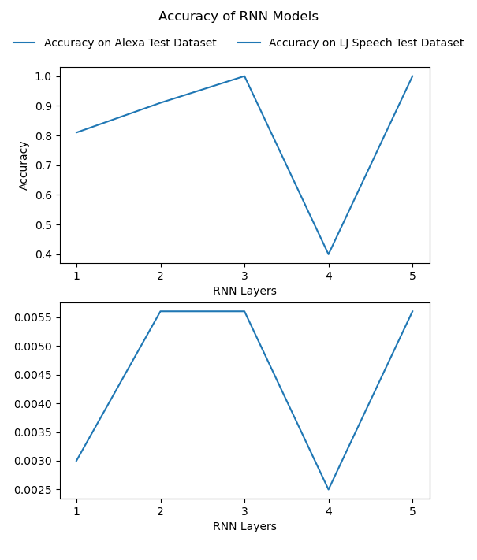
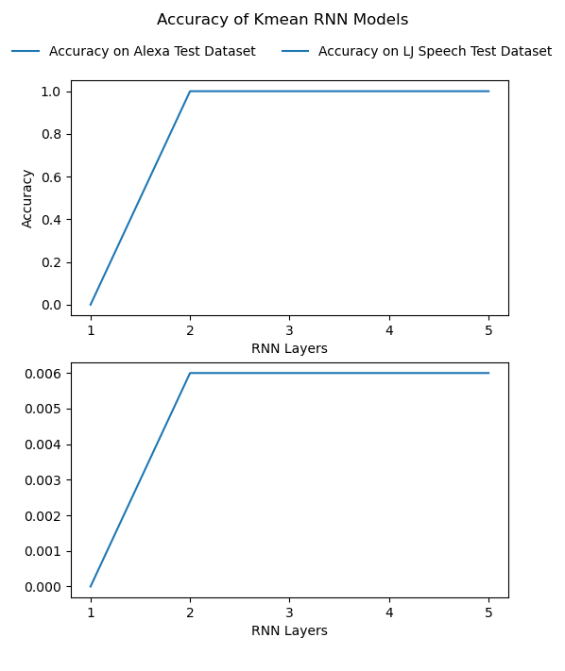
Tests/ Graphs

Slide 11
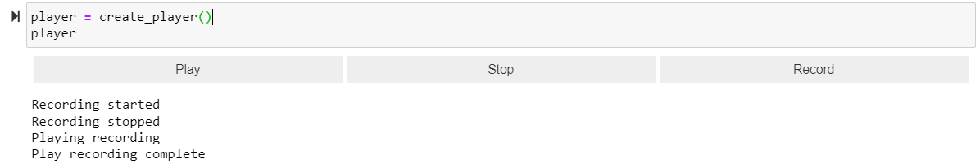
Prediction Demo

Slide 12
Constraints and Limitations
Fairness and Bias
The availability of datasets. We used two datasets: one with only one word (Alexa) but in different voices and accents, and the other dataset with just one voice, but different words.
Computation limitation. With many layers including convolutions, models take a very long time to run. Due to this, we couldn't train a full dataset, train more models, or train our models with a general speech without access to significantly more compute power.
A lot of data engineering, as we had to convert audio files to spectrogram and then to data features before we could build our models
Bias issues with ASR models: lack of inclusion and diversity in the voices and accents of training data
We used the LJ Speech dataset is large, but introduces bias
Though it is a large dataset, it consists of only a single voice and accent.
The second dataset (Alexa dataset) has a single word (Alexa) in many different voices and accents, and therefore is more representative, but the size of the dataset is small.

Slide 13
Thank You!
Questions?

